Slide 1

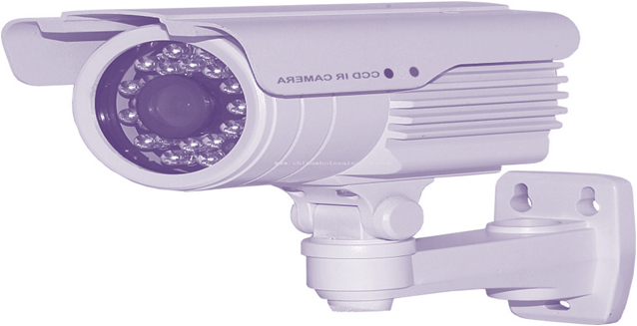
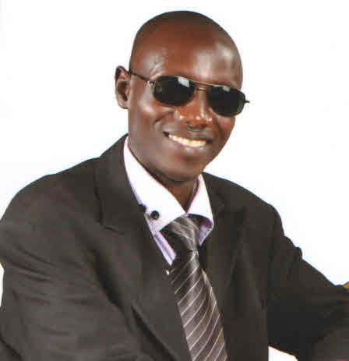

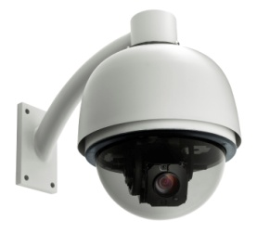
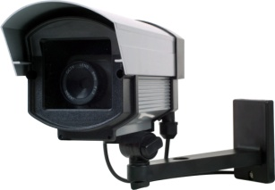
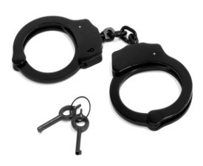
By Atine Olugo Richard CCTV Training, Analysis, Operations & Investigations
CCTV Department Parliament - Kampala -U-
BSc (KYU), DIP, IT(UICT Nakawa),Cert(CCTV)
Tel: 0717179612/ 0782283804/ 0753283804

Slide 2
Weather
Inadequate training & awareness
Social Network interference
Simplification of incidents
Poor quality of Cameras
Poor coordination
Obstruction/interference
Negative perception

Slide 3
CHALLENGES CONT’D
Inadequate training for competence and expertise
Lack of policing
Lack of patriotism
Lack of motivation
Weak CCTV bylaws
Political Interference
Insecurity

Slide 4
CONT’D
Individual interest
Incident time lapse
Inadequate funds/facilitation
Inadequate CCTV forensic equipments
Ignorance
Distance
Corruption

Slide 5
CONT’D
Competition.
Changing settings of incidents
Camera focus & positioning
Poor and low Storage capacity
Inadequate cctv experts(training, scene analysis &investigations)
Inadequate manpower/cctv analysts E.T.C
END

